Slide 1
Notes:
Brief intro about myself, and how did I start on the project: asking around, no success… found a dataset which did not allow for Hidden Markov where I wanted… And then I decided to build microscope or telescope

Slide 2

Notes:
Boom shakalaka

Slide 3
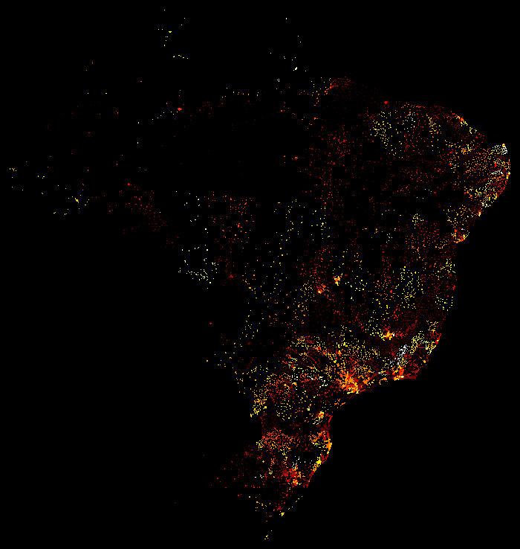
Notes:
Just to make sure video does not repeat or stop in an unwanted frame

Slide 4
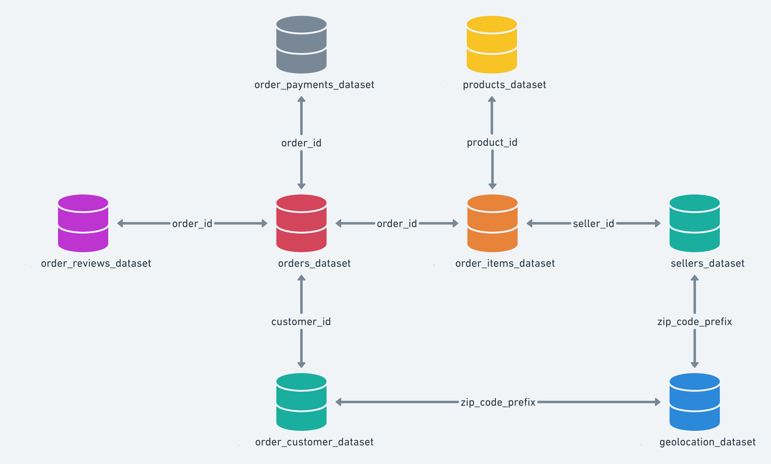
Entity Relationship Diagram (ERD)
Notes:
Explanation of the data structure

Slide 5
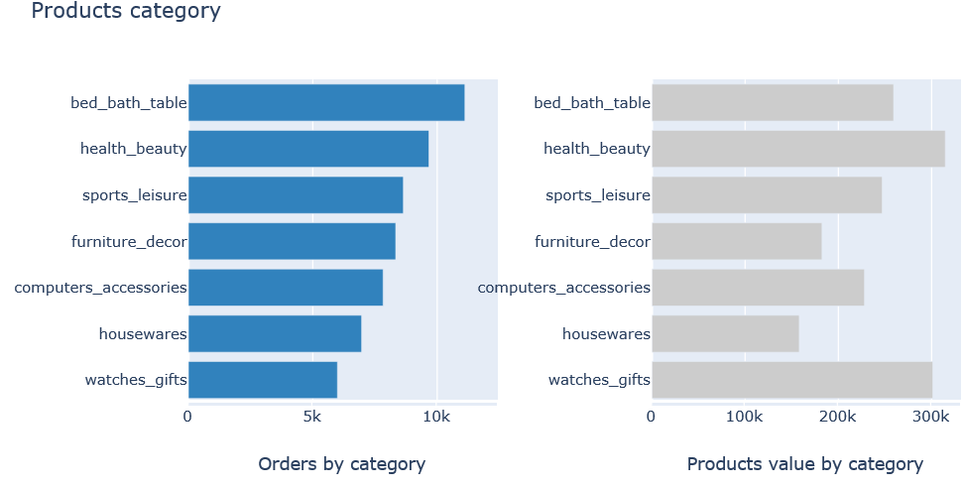
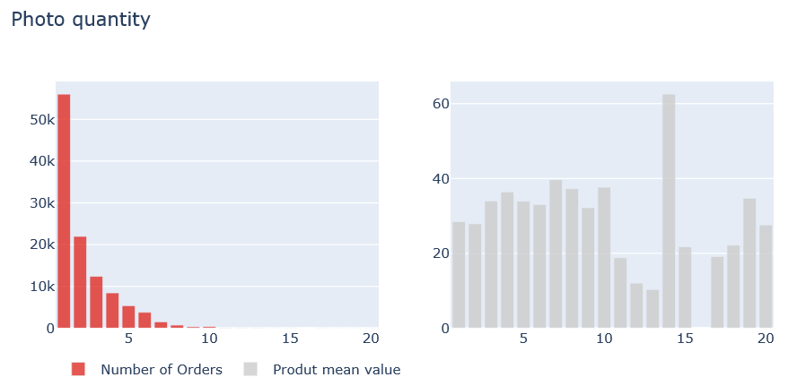
What is the website offering?
Notes:
Specific review of what is the company selling and give a first insight of the money they are making with that

Slide 6
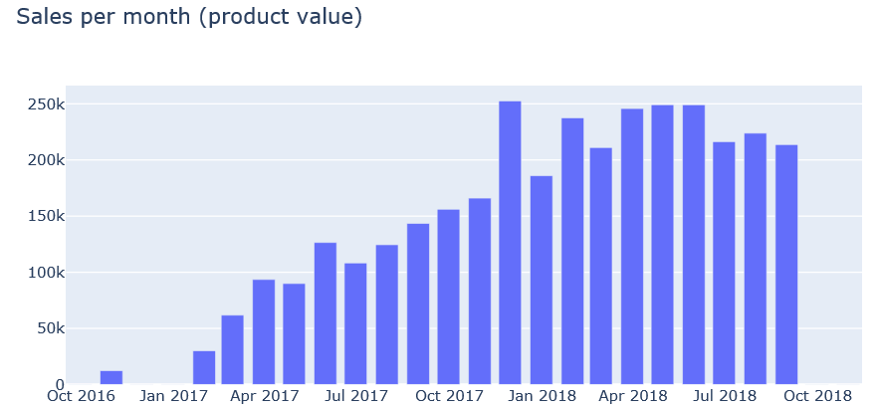
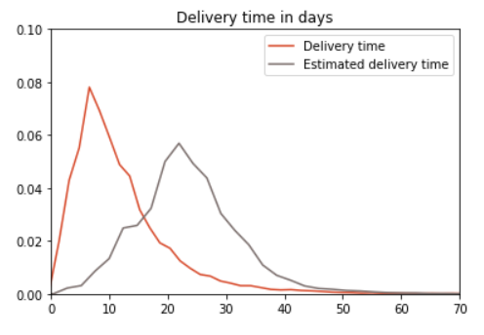
How is the website doing?
Will they grow?
Will they stagnate?
Will they schrink?
Are customers happy?
Is it the wrong prediction model?
Notes:
Talk a bit about the evolution of the revenue generated and the delivery, which is how the products are actually received

Slide 7
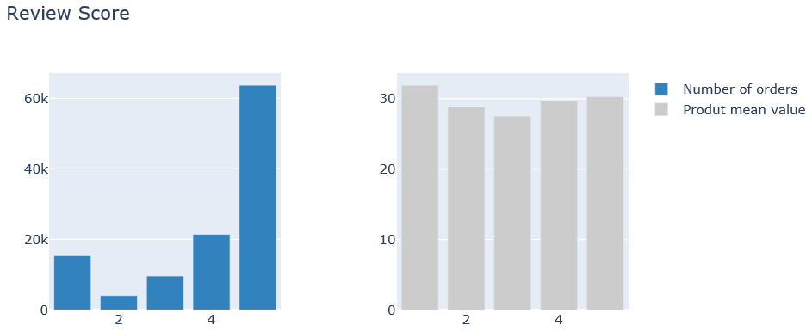
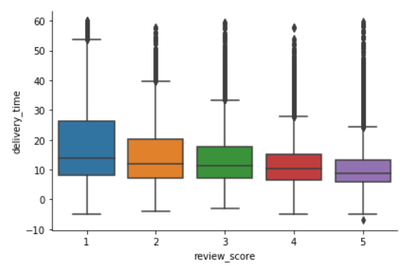
Customer Voice = Reviews
- Seems that 1/3 of the clientele
Is not happy
- Seems that delivery time has
something to do with it

Slide 8
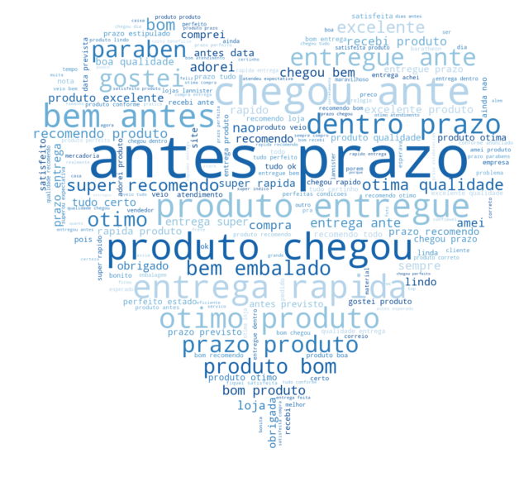
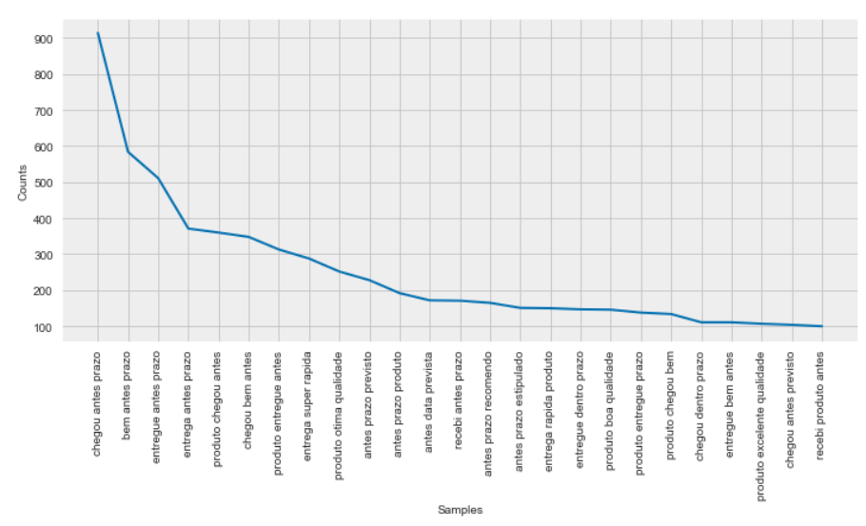
This is what their customers say:
Blue heart of love says:
Before estimate
Simple NLP stack
Using NLTK library
Notes:
Comment that the NLP is machine learning, that is where it starts after analytics. That NLTK is because of portuguese language

Slide 9
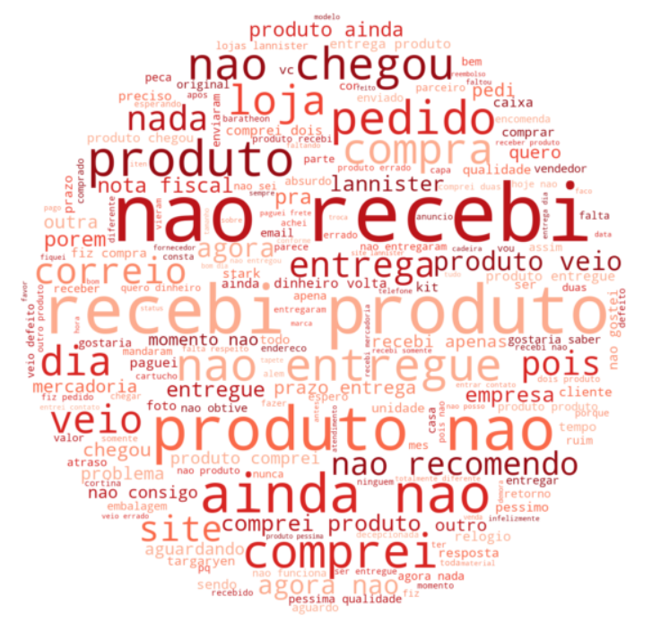
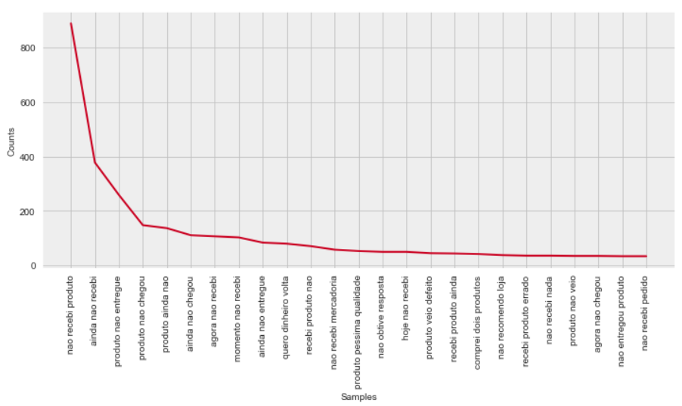
Benefits of customer voice:
Red tomato of hate says:
I did not receive it
All the review processing
is now automated
Employees can now avoid
negativity, focus on supply
chain, etc…
Notes:
Explain the benefits of implementing this, its yuuuuuuuge

Slide 10
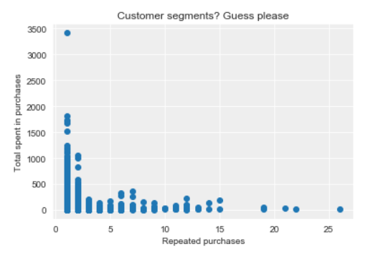
Still how is the website doing?
Will they grow?
Will they stagnate?
Will they schrink?
Let me help a bit:
Notes:
Let the public have a small thought on this one before presenting unsupervised learning

Slide 11
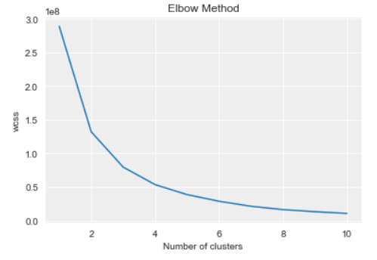
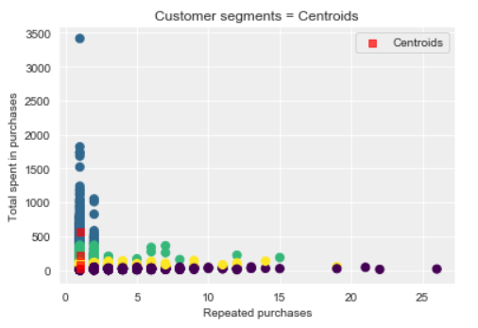
So how is the website doing?
Will they grow? Depends on customer acquisition/retention strategy (marketing)
Will they stagnate? During transition period while changing strategy
Will they schrink? If they do not change anything yes, with at least 80% confidence
Notes:
Let the public have a small thought on this one before presenting unsupervised learning

